Slide 1

SRINIVASA INSTITUTE OF ENGINEERING AND TECHNOLOGY (UGC-Autonomous) BACHELOR OF TECHNOLOGY IN COMPUTER SCIENCE AND ENGINEERING
Computer Science and Engineering
Presented by:
HEMA LAKSHMI BOKKA(226N1A0512)

Slide 2
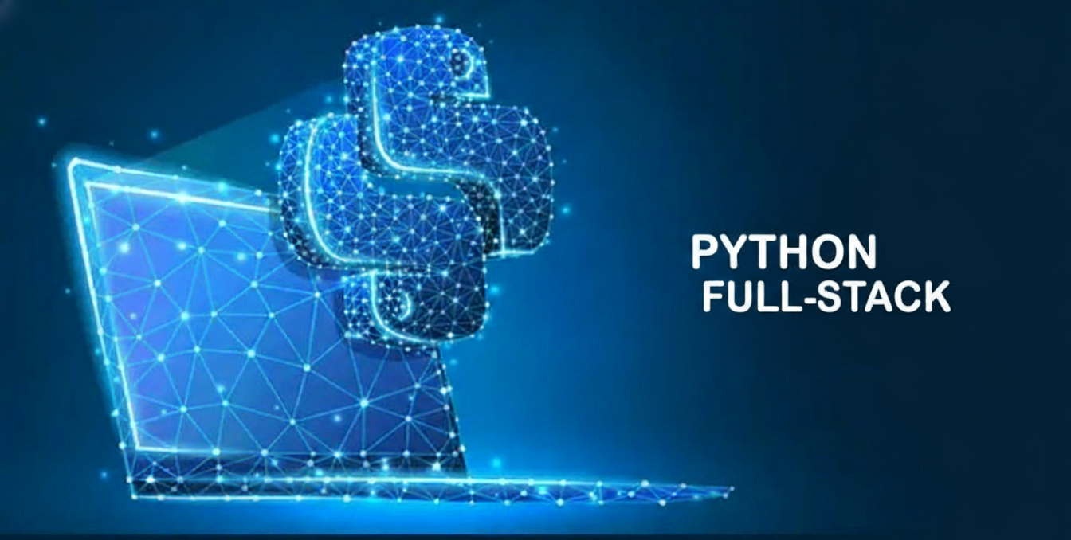
Presented By : Bokka Hema Lakshmi Department : Computer Science Engineering Duration : 10 weeks

Slide 3
Contents:
Introduction to python
What is full Stack?
The Full-Stack Flow (Request-Response Cycle)
Front-End (The Client-Side)
Front-End Technologies
Front-End Role
Flow chart of front-end
Back-End (The Server-Side)
Back-End Technologies
Integration: Front-End & Back-End
Python Frameworks
Project overview
LEARNING OUTCOMES

Slide 4

Introduction to python
Python is a computer programming language.
Python is a high-level, general-purpose programming language.
Developed By : Guido van Rossum.
Start of Development: December 1989
Python is a versatile programming language used in a wide range of applications.

Slide 5
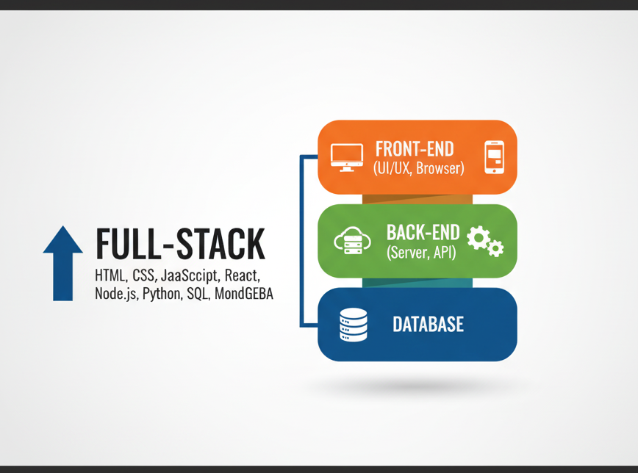
What is full Stack?
Full Stack : The ability to develop and manage both the "front-end" and "back-end" of a software application or website(in simple terms front-end + back-end ).
Frontend : Everything a user sees and interacts with directly(in simple terms UI – user Interface).
Backend: The hidden part that handles the logic, data storage, and server operations.
Full Stack Developers: A full stack developer is a software engineer who can work on both the front-end and back-end of an application.
Technologies
Frontend : HTML, CSS, and JavaScript.
Backend : Python , Java, Ruby, or PHP, and frameworks like Django, Spring, or Node.JS

Slide 6
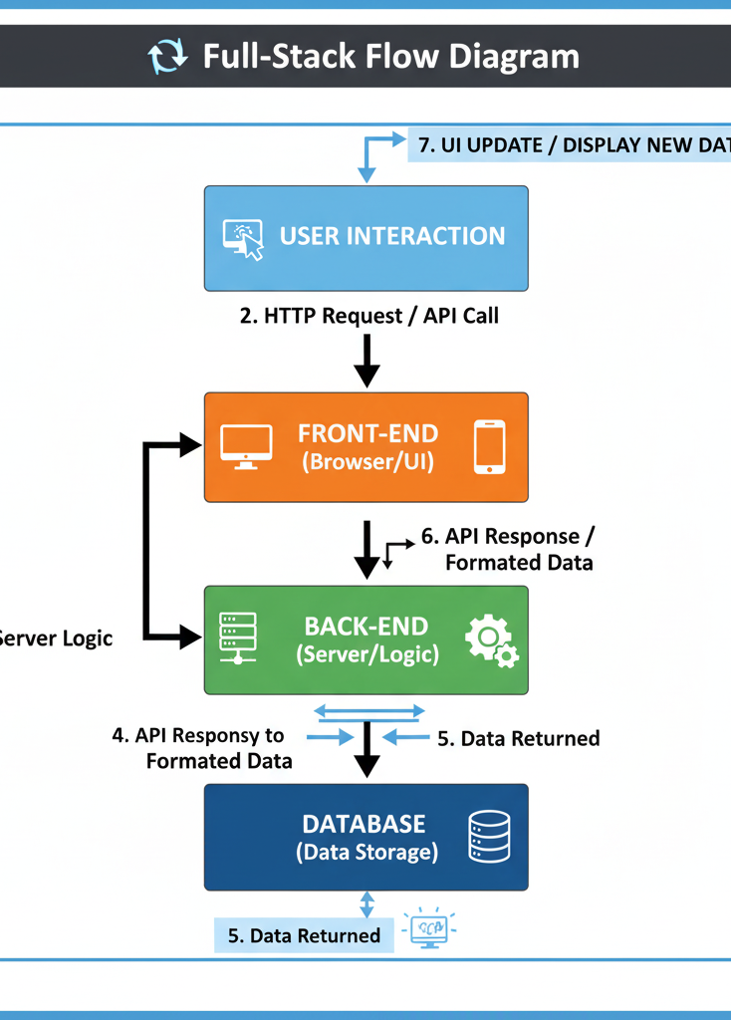
The Full-Stack Flow (Request-Response Cycle)
User Action : The user interacts with the UI (e.g., clicks "Login," submits a form, or clicks "Buy").
Request Sent : An API call (like an HTTP request) to the server.
Server Logic : The server receives the request, verifies the user's identity and runs the necessary logic.
Data Query : The Back-End code sends a query (a command) to the Database to save, retrieve, or update the required data.
Data Response: The Back-End organizes the data, formats it into a standard package (usually JSON), and sends a response back to the browser.
Final Response :The Database executes the query and sends the raw result (the data) back to the Back-End.
UI Update : The Front-End receives the final response and updates the visible part of the web page to reflect the new data (e.g., shows the user is logged in, displays a new comment, or loads product details.

Slide 7
Front-End (The Client-Side)
The Front-End is everything the user sees and interacts with on a website or app. It runs entirely inside the user's browser.
User Interface (UI): It creates the look and feel—the buttons, text boxes, images, and overall design.
Interactivity: It handles all the immediate actions, like drop-down menus opening, buttons changing color when you hover over them, and instant error messages.
Client User Interface sends request to Back-end
The Front-End receives raw data from the Back-End and translates it using HTML, CSS, and JavaScript to visually render the final, understandable content for the user.

Slide 8
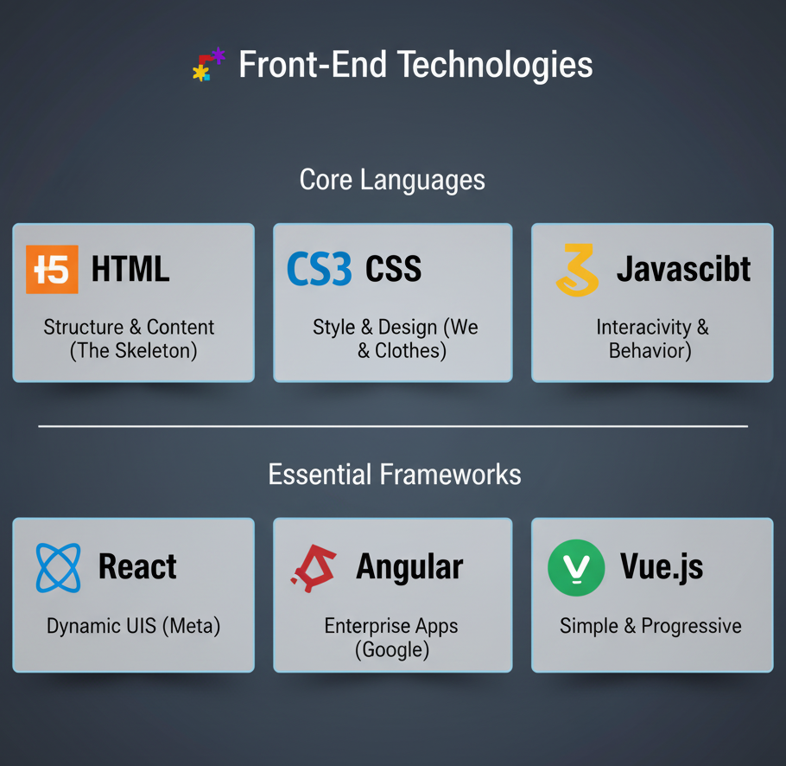
Front-End Technologies
Core Front-End Technologies
HTML: The structure and content (like the skeleton of a building).
CSS: The style and presentation (like the paint, colors, and layout).
JavaScript: The behavior and interactivity (like the electricity and moving parts).
Essential Frameworks & Libraries
ReactJS: A popular JavaScript library (from Meta) used to build dynamic, fast user interfaces by breaking the UI into reusable components.
AngularJS: A comprehensive JavaScript framework (from Google) for building large-scale, enterprise-level web applications.

Slide 9
Front-End Role
Presents Everything: Uses HTML and CSS to build the entire visual interface (the look, feel, and layout).
Captures User Action: Records all clicks, taps, and keyboard input from the user.
Validates Input: Quickly checks forms for simple errors before talking to the server.
Initiates Communication: Formats and sends API requests to the Back-End when data is needed.
Translates Data: Takes the raw JSON data from the Back-End and translates it into readable content.
Renders Updates: Instantly updates the screen (like a new post loading) without reloading the page.

Slide 10
Flow chart of front-end
CLIENT'S COMPUTER |(User's Device/Browser)
(Loads HTML, CSS, JS files)
USER INTERFACE |
(The Website/App HTML ,CSS , JavaScript )
(User Interaction: Click, Type) | (JavaScript captures and validates input)
FRONT-END APPLICATION
(Browser-side Code)
Data Validation |,Formats API Request
(Sends HTTP Request / API Call)
WEB SERVER |
(Back-End Start) |
Receives Request

Slide 11
Back-End (The Server-Side)
The Back-End is the application's "brain" that runs on a remote server. It handles data, logic, and security—everything the user doesn't see.
Logic and Rules: This is where the core functionality lives. It processes requests, verifies user actions, and runs the complex rules of the application (e.g., calculating prices, filtering results).
Data Management: The Back-End communicates directly with the Database to store, retrieve, and update all critical information (user profiles, product details, posts, etc.).
API(Application Programming Interface): The Back-End exposes specific routes or endpoints (the API) that the Front-End uses to make requests and get data. It's the secure middleman.
Receive and Validate Process Logic Manage Data (I/O) Send Final Response

Slide 12
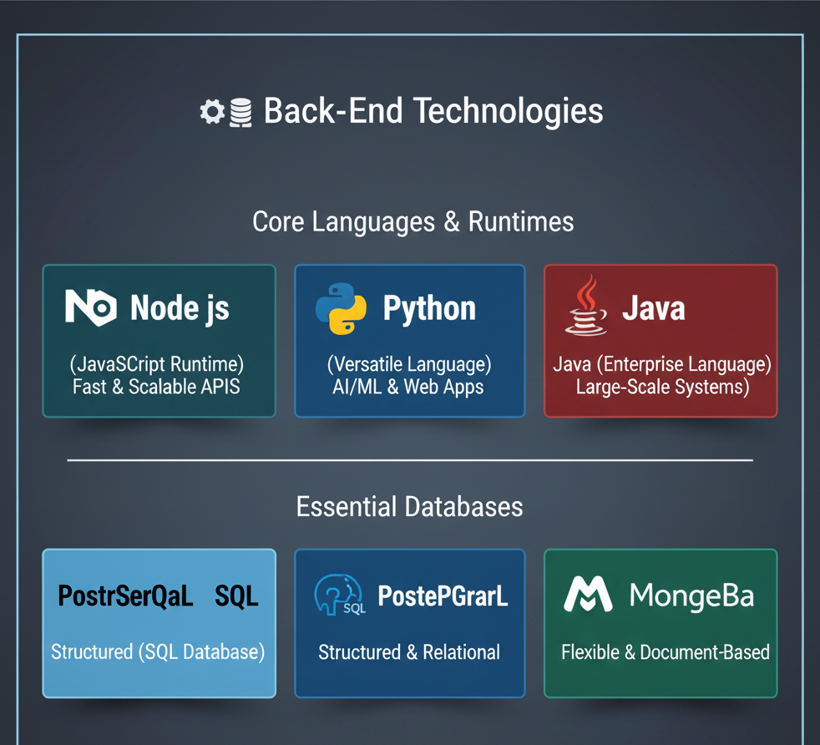
Back-End Technologies
Server-Side Languages/Runtimes:
Node.js:Logo. Text: "Uses JavaScript for server-side logic.“
Python :Logo Text: "Great for data analysis and complex logic (Django/Flask).“
Java :Logo Text :"Enterprise-level and highly scalable applications (Spring).“
Python : Dynamic and simple programing language
Databases (Data Storage):
MySQL/PostgreSQL: SQL logo. Text: "Relational (Structured Data)“.
MongoDB: Logo. Text: "NoSQL (Flexible Document Storage)."

Slide 13
Back-End Role
Manages User Identity: Handles all login, sign-up, and password security. It confirms identity or Authentication.
Controls Permissions : Checks if a user has the authority to perform an action (e.g., stopping a regular user from accessing admin settings).
Runs Business Logic: Executes all the complex calculations and core rules of the application (e.g., processing transactions, filtering search results).
The Data Custodian: Responsible for the safe storage and retrieval of all critical data (posts, profiles, inventory) in the Database.
Serves the Front-End: Formats and prepares the requested data into a clean API response (JSON) and sends it back to the Front-End.

Slide 14
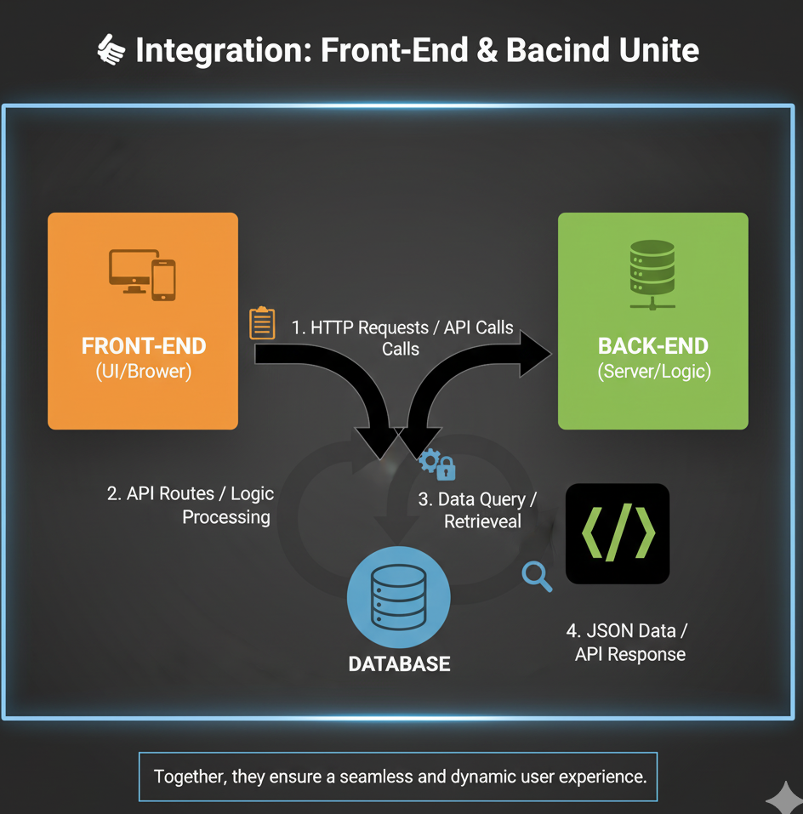
Integration: Front-End & Back-End
Front-End Asks: The Front-End first takes the user's action (like clicking a button or typing a comment).
Back-End Thinks: It hands that action over to the Back-End, which processes the information and decides what needs to happen next.
Database Remembers: The Back-End asks the Database to either save new information or get the required data (like fetching all your old posts).
Final Delivery: The Back-End takes the final result and sends it right back to the Front-End, so the user can see the change on their screen!
Simple Example (Logging In):
You Click & Front-End Asks: The Front-End sends your details to the Back-End, which immediately checks the Database.
Result Sent & Shown: The Back-End sends the success/fail message back, and the Front-End instantly updates your screen.

Slide 15
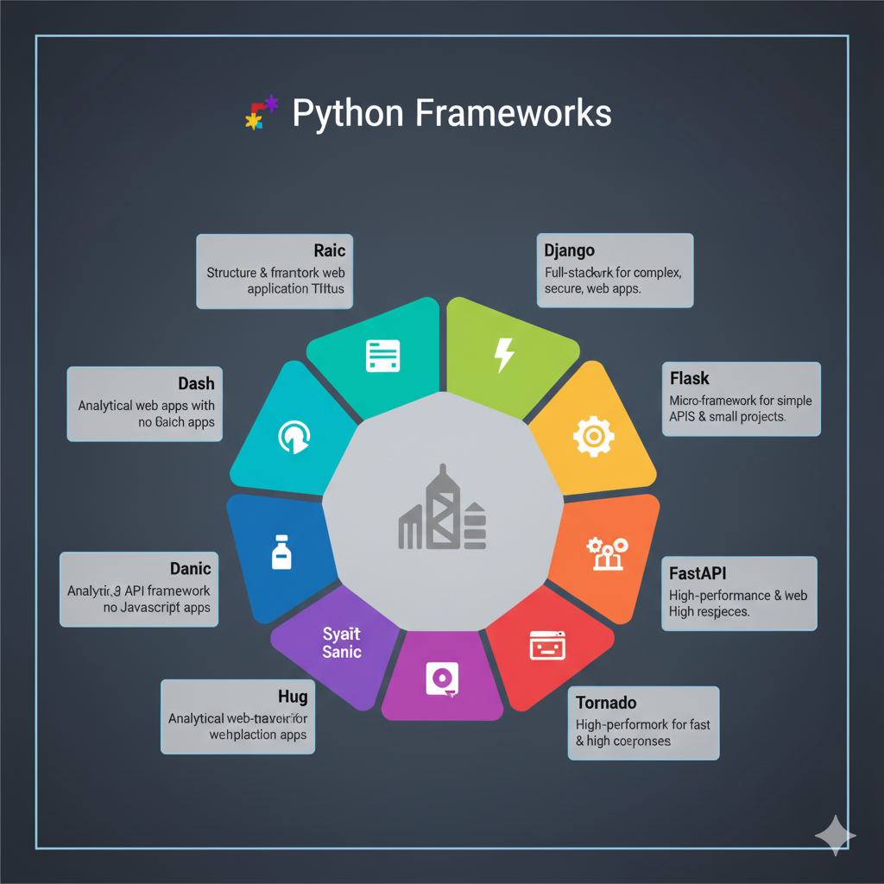
Python Frameworks

Slide 16
Python Full-Stack Applications
E-commerce Platform 🛒
Data Dashboards 📈
Content Management 📰
Cybersecurity Tools 🔒
AI/ML Back-Ends 🧠
Social Networking 👥
Financial Trackers 💰
Automation Systems 🤖
Real-Time Apps ⚡
Educational Platforms 📚
Logistics & Inventory 📦
APIs as a Service 🌐
Health & Fitness Trackers 💪
IoT Back-Ends 📡
GIS/Mapping Tools 🗺️
Event Booking/Ticketing 🎟️

Slide 17
SIGNIFICANCE OF FULL-STACK PYTHON DEVELOPMENT
Cost-Effectiveness for Businesses
Strong Community Support and Resources
Scalability and Robustness
Foundation for Advanced Technologies
Increased Job Opportunities and Flexibility
Efficient Development and Rapid Prototyping

Slide 18
Project overview
During my Python Full Stack internship, I developed a web application using front-end and back-end technologies. I designed web pages using HTML, CSS, and JavaScript, and created the back-end using Python with Django or Flask. I connected the website to a database like MySQL to store data. Through this project, I learned how the front-end, back-end, and database work together to build a complete and functional web application.

Slide 19
LEARNING OUTCOMES
I learned to make web pages using HTML, CSS, and JavaScript
I learned to write back-end code using Python and Django/Flask.
I learned to use databases like MySQL and MongoDB.
I learned how front-end and back-end work together.
I improved my problem-solving.

Slide 20
Conclusion
This internship was a transformative experience, cementing my technical foundation in Python Full-Stack development. I successfully mastered the complete MVT (Model-View-Template) architecture using frameworks like Django, taking projects from database modeling to API design and deployment. Beyond coding, I gained practical exposure to Linux environments and the critical importance of application security. This work required me to adopt systematic, professional methodologies in version control and quality assurance. I now feel completely confident in my ability to manage the entire development lifecycle.

Slide 21
Thank you

